Slide 1



PIMPRI CHINCHWAD EDUCATION TRUST’S S.B.PATIL COLLEGE OF Science and Commerce, Ravet
3. Advanced Javascript
Index:
Features of JavaScript, difference between client side scripting and server side scripting.
Looping structures.
DOM Objects and window object in JavaScript.
Inbuilt objects such String, Math, Array, Date and Number with its properties and Methods.
Simple JavaScript programs to do validations and user interaction.
From:
Mrs. Shilpa Prashant Kate (IT Teacher)
S.B.Patil college of Science & Commerce,Ravet

Slide 2
Introduction
PIMPRI CHINCHWAD EDUCATION TRUST’S S.B.PATIL COLLEGE OF Science and Commerce, Ravet
Program is a set of instructions used to produce various kinds of outputs
JavaScript is an interpreted scripting language. An interpreted language is a type of programming language that executes its instructions directly.
JavaScript was initially created to "make webpages alive". The programs in this language are called scripts.
3.1.1 Features of JavaScript
JavaScript is light weight scripting language because it does not support all features of object oriented programming languages No need of special software to run JavaScript programs
JavaScript is object oriented scripting language and it supports event based programming facility. It is case sensitive language.
JavaScript helps the browser to perform input validation without wasting the user's time by the Web server access.
It can handle date and time very effectively.
Most of the JavaScript control statements syntax is same as syntax of control statements in other programming languages.
An important part of JavaScript is the ability to create new functions within scripts. Declare a function in JavaScript using function keyword.
Software that can run on any hardware platform (PC, Mac, SunSparc etc.) or software platform (Windows, Linux, Mac OS etc.) is called as platform independent software. JavaScript is known as universal client side scripting language.

Slide 3
3.1.2 Difference between Server side scripting and client side scripting
PIMPRI CHINCHWAD EDUCATION TRUST’S S.B.PATIL COLLEGE OF Science and Commerce, Ravet
Server Side scripting
Client side scripting
Server-side scripting is used at the backend, where the source code is not visible or hidden at the client side (browser). Server-side scripting is more secure than client-side scripting
When a server-side script is processed it communicates to the server.
programming languages such as PHP, ASP.net, Ruby, ColdFusion, Python, C# etc. are server side scripting languages.
Server-side scripting is useful in customizing the web pages and implements the dynamic changes in the websites.
Special software (web server software) is required to execute server-side script
client- side scripting is used at the frontend which users can see source code from the browser.
client-side scripting does not need any server interaction.
The client-side scripting language involves languages such as HTML5, JavaScript etc.
client- side scripts are generally used for validation purpose and effectively minimize the load to the server.
client side scripts requires web browser as an interface.

Slide 4
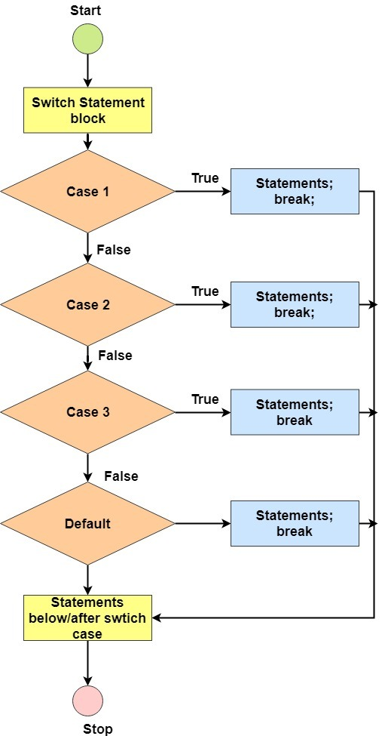
PIMPRI CHINCHWAD EDUCATION TRUST’S S.B.PATIL COLLEGE OF Science and Commerce, Ravet
3.2 Switch case and Looping Structures
3.2.1 Switch Case statement
JavaScript has a built–in multiway decision statement known as Switch. The switch statement test the value of given expression against a list of case values and when match is found, a block of statement associated with that case is executed.
There should not be duplicity between the cases.
The value for the case must be similar data type as the variable in switch.
The default statement is not mandatory.
Syntax :
switch(expression)
{
case value1:
statement block 1; break;
case value2:
statement block 2; break;
…………....
case value n:
statement block n; break;
default:
statement block ;
}

Slide 5
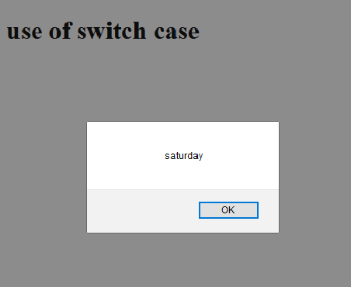
3.1.2 Difference between Server side scripting and client side scripting
PIMPRI CHINCHWAD EDUCATION TRUST’S S.B.PATIL COLLEGE OF Science and Commerce, Ravet
<!DOCTYPE html>
<head><title>Javascript Program
</title></head>
<body>
<h1> use of switch case </h1>
<script type="text/javascript"> var day=6;
switch(day)
{
case 1: alert(“Monday”); break;
case 2: alert(“Tuesday”); break;
case 3: alert(“Wednesday”); break;
case 4: alert(“Thursday”); break;
case 5: alert(“Friday”); break;
case 6: alert(“Saturday”); break;
case 7: alert(“Sunday”); break;
default: alert("Invalid day");
}
</script></body></html>

Slide 6
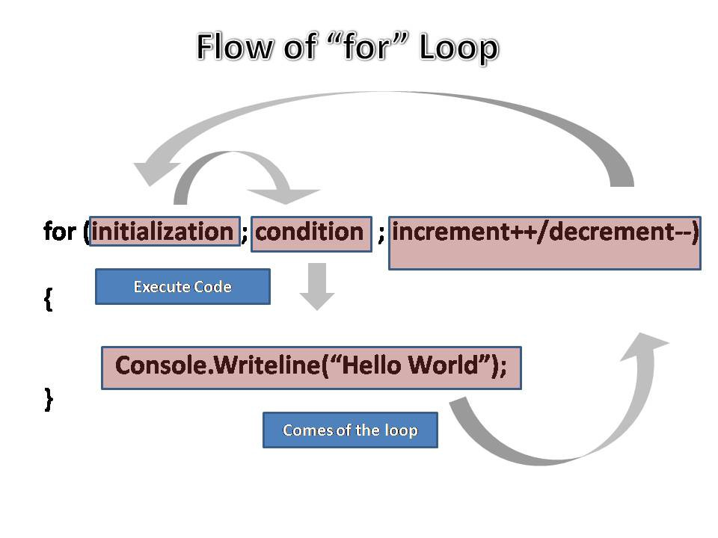
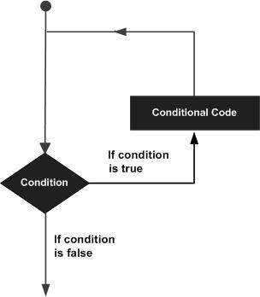
3.2.2 Looping statement
PIMPRI CHINCHWAD EDUCATION TRUST’S S.B.PATIL COLLEGE OF Science and Commerce, Ravet
To execute some statement need to execute repeatedly. Iteration refers to the execution of statement or a group of statements of code for a fixed number of times or till the condition is satisfied.
The condition should be Boolean condition.
Some commonly used JavaScript looping statements are:
1)For loop
2)While loop
document.writeln(i)

Slide 7
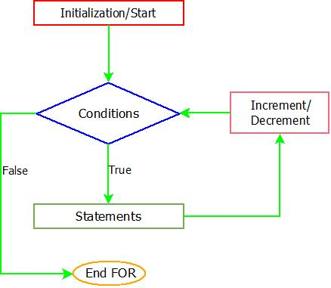
PIMPRI CHINCHWAD EDUCATION TRUST’S S.B.PATIL COLLEGE OF Science and Commerce, Ravet
1. for…….loop
This loop executes statements as long as condition becomes true, for-loop is that it combines initialization, condition and loop iteration (increment or decrement) in single statement.
Syntax :
for(initialization;condition;iteration)
{
statement block;
}
Note : 'language' attribute of <Script> is replaced by 'type' attribute in all the programs as it is standardized.

Slide 8
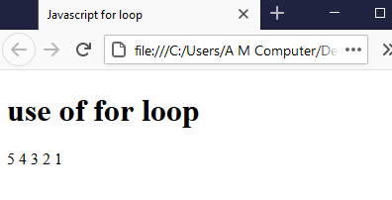
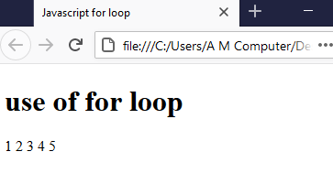
3.2.2 example of for loop
PIMPRI CHINCHWAD EDUCATION TRUST’S S.B.PATIL COLLEGE OF Science and Commerce, Ravet
<!DOCTYPE html>
<head><title>Javascript for loop</title></head>
<body><h1> use of for loop</h1>
<script type="text/javascript">
for(i=1;i<=5;i++)
{
document.writeln(i);
}
</script>
</body>
</html>
<!DOCTYPE html>
<head><title>Javascript for loop</title></head>
<body><h1> use of for loop</h1>
<script type="text/javascript">
for(i=5;i>=1;i--)
{
document.writeln(i);
}
</script>
</body>
</html>
OUTPUT
OUTPUT

Slide 9
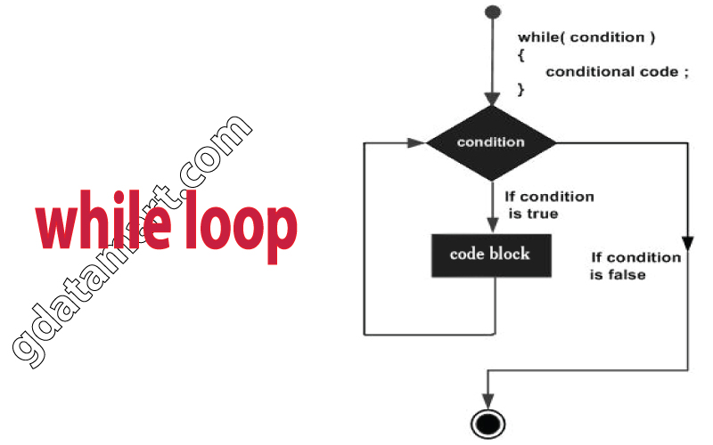
2. While…..loop This loop executes statements as long as the condition is true. As soon as condition becomes false control comes out of the loop.
PIMPRI CHINCHWAD EDUCATION TRUST’S S.B.PATIL COLLEGE OF Science and Commerce, Ravet
Syntax:
initialization; while(condition)
{
statement block;
}

Slide 10
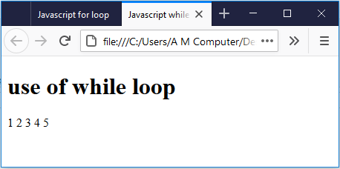
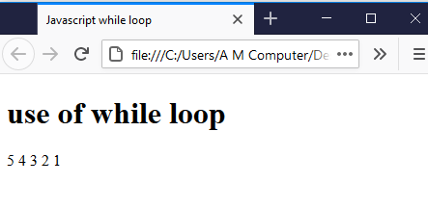
3.1.3 example of while loop
PIMPRI CHINCHWAD EDUCATION TRUST’S S.B.PATIL COLLEGE OF Science and Commerce, Ravet
<!DOCTYPE html>
<head><title>Javascript while loop</title></head>
<body><h1> use of while loop</h1>
<script type="text/javascript">
var i=1
while(i<=5)
{
document.writeln(i);
i=i+1;
}
</script></body> </html>
<!DOCTYPE html>
<head><title>Javascript while loop</title></head>
<body> <h1> use of while loop</h1>
<script type="text/javascript">
var i=5
while(i>=1)
{
document.writeln(i);
i=i-1;
}
</script> </body> </html>
OUTPUT
OUTPUT

Slide 11
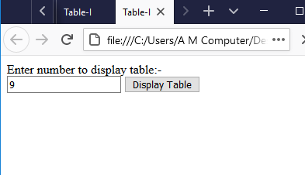
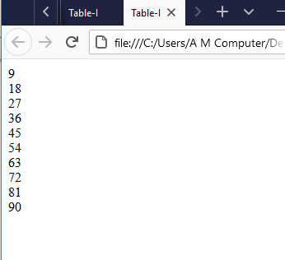
Accept number and display the table of that number
PIMPRI CHINCHWAD EDUCATION TRUST’S S.B.PATIL COLLEGE OF Science and Commerce, Ravet
<!DOCTYPE html>
<head><title>Table-I</title>
<script type="text/javascript">
function display()
{
var i, a; a=form1.t1.value
for(i=1;i<=10;i++)
{
document.write(a*i + "<br/>");
}
}
</script></head> <body>
Enter number to display table:-
<form name="form1">
<input type="text" name="t1">
<input type="button" value="Display Table" onClick="display()">
</body></html>

Slide 12
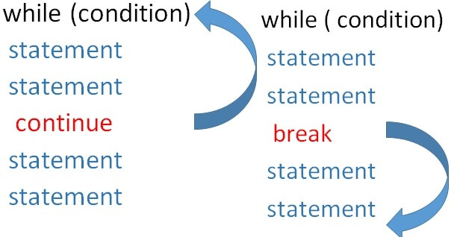
PIMPRI CHINCHWAD EDUCATION TRUST’S S.B.PATIL COLLEGE OF Science and Commerce, Ravet
Break and continue statements
Break statement is used to jump out of loop. It is used to make an early exit from a loop. When keyword break is encountered inside the loop, control automatically passes to the next statement after the loop.
Continue statement: In looping it may be necessary to skip statement block and take the control at the beginning for next iteration. This is done by using ‘continue’ statement in JavaScript.
Note : 'language' attribute of <Script> is replaced by 'type' attribute in all the programs as it is standardized.

Slide 13
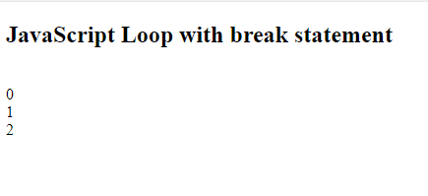
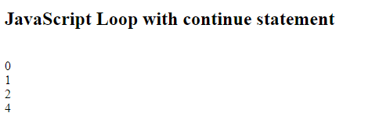
PIMPRI CHINCHWAD EDUCATION TRUST’S S.B.PATIL COLLEGE OF Science and Commerce, Ravet
Break and continue statements
<!DOCTYPE html>
<html>
<body>
<h2>JavaScript Loop with break statement</h2>
<script type=“text/javascript”>
var i;
for (i = 0; i < 5; i++) {
if (i == 3)
{ break; }
document.write("<br>"+i);
}
</script>
</body>
</html>
<!DOCTYPE html>
<html>
<body>
<h2>JavaScript Loop with continue statement</h2>
<script type=“text/javascript”>
var i;
for (i = 0; i < 5; i++) {
if (i ==3)
{ continue;}
document.write("<br>"+i);
}
</script>
</body>
</html>
OUTPUT
OUTPUT
Note : 'language' attribute of <Script> is replaced by 'type' attribute in all the programs as it is standardized.

Slide 14
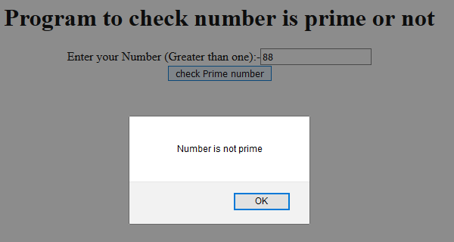
Number is prime or not
PIMPRI CHINCHWAD EDUCATION TRUST’S S.B.PATIL COLLEGE OF Science and Commerce, Ravet
<body>
<h1 align="center"> Program to check number is prime or not </h1>
<form name="form1" style="text-align:center">
Enter your Number (Greater than one):-
<input type="text" name="t1"> <br>
<input type="button" value="check Prime number" onClick="display()">
</body>
</html>
<!DOCTYPE html>
<html><head><title>Prime number</title>
<script type="text/javascript"> function display()
{
var a,ans;
a=parseInt(form1.t1.value); ans=1;
for(i=2;i<a; i++)
{
if(a%i==0)
{
ans=0; break;
}
}
if(ans==1)
alert("Number is prime"); else
alert("Number is not prime");
}
</script></head>

Slide 15
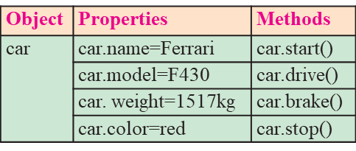
PIMPRI CHINCHWAD EDUCATION TRUST’S S.B.PATIL COLLEGE OF Science and Commerce, Ravet
3.3 Objects in JavaScript
JavaScript is an object based scripting language. Almost everything is an object in JavaScript.
A JavaScript object is an entity having state (properties) and behavior (methods). An object can group data together with functions needed to manipulate it.
Examples of real world objects. as table, board, television, bicycle, shop, bus, car, monitor etc. All these tangible things are known as objects.
Properties and methods of object's are accessed with '.' operator.
JavaScript supports 2 types of objects built-in objects and user defined objects.
Built in objects such as Math, String, Array, Date etc.
As per user requirements can create user defined objects
The ‘new’ keyword is used to create new object in JavaScript.
e.g. d= new Date();
Take an example of car object.
It has properties like name, model, weight, color etc. and methods like start, stop, brake etc.
All cars have same properties but contain different values from car to car.
All cars have same methods but perform differently.
Note : 'language' attribute of <Script> is replaced by 'type' attribute in all the programs as it is standardized.

Slide 16
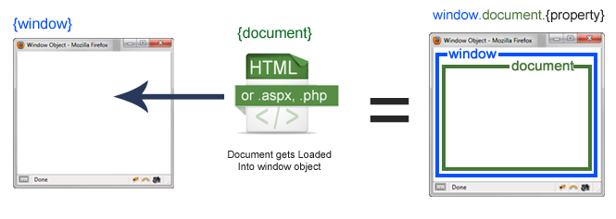
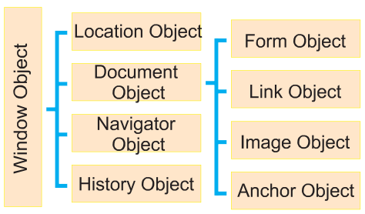
PIMPRI CHINCHWAD EDUCATION TRUST’S S.B.PATIL COLLEGE OF Science and Commerce, Ravet
DOM (Document Object Model) :
When HTML document is loaded into a web browser, it becomes a document
The W3C Document Object Model (DOM) is a platform and language- neutral interface that allows programs and scripts to dynamically access and update the content, structure, and style of a document."
Following diagram shows hierarchy of DOM object:

Slide 17
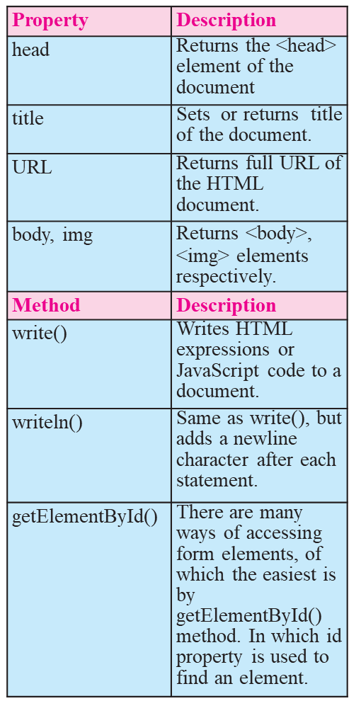
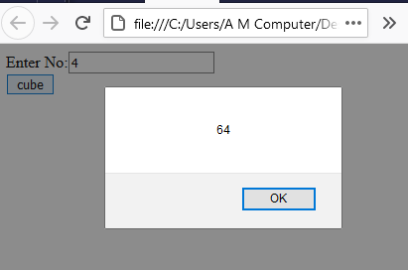
PIMPRI CHINCHWAD EDUCATION TRUST’S S.B.PATIL COLLEGE OF Science and Commerce, Ravet
form1.name.value to get the value of the input value.
Instead of this,
document.getElementById() to get value of the input text.
But we need to define id for the input field.
<!Doctype html>
<html>
<head>
<script type="text/javascript">
function getcube(){
var number=document.getElementById("number").value;
alert(number*number*number);
}
</script>
</head>
<body>
<form>
Enter No:<input type="text" id="number" name="number"/><br/>
<input type="button" value="cube" onclick="getcube()"/>
</form>
</body>
</html>
output

Slide 18
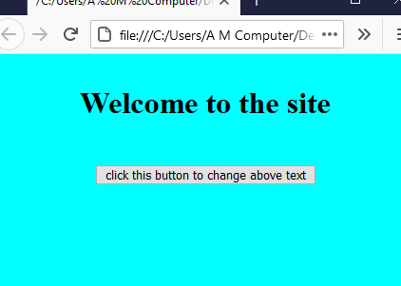
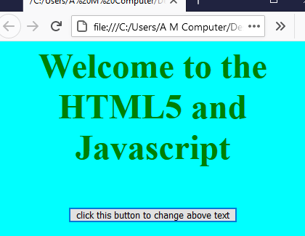
PIMPRI CHINCHWAD EDUCATION TRUST’S S.B.PATIL COLLEGE OF Science and Commerce, Ravet
The innerHTML Property : used to write the dynamic html on the html document.
The innerHTML property is useful for getting html element and changing its content. The innerHTML property can be used to get or change any HTML element, including <html> and <body>.
Before button click
<!DOCTYPE html>
<html>
<head>
<script type="text/javascript">
function changeText3()
{
var style="<h1 style= 'color:green'>";
var text="Welcome to the HTML5 and Javascript";
var closestyle="</h1>";
document.getElementById('para').innerHTML=style+text+closestyle;
}
</script></head>
<body style="background-color:cyan">
<h1 align="center">
<p id="para">Welcome to the site</p>
<input type="button" onclick="changeText3()" value="click this button to change above text">
</h1>
</body>
</html>
Output
After button click

Slide 19
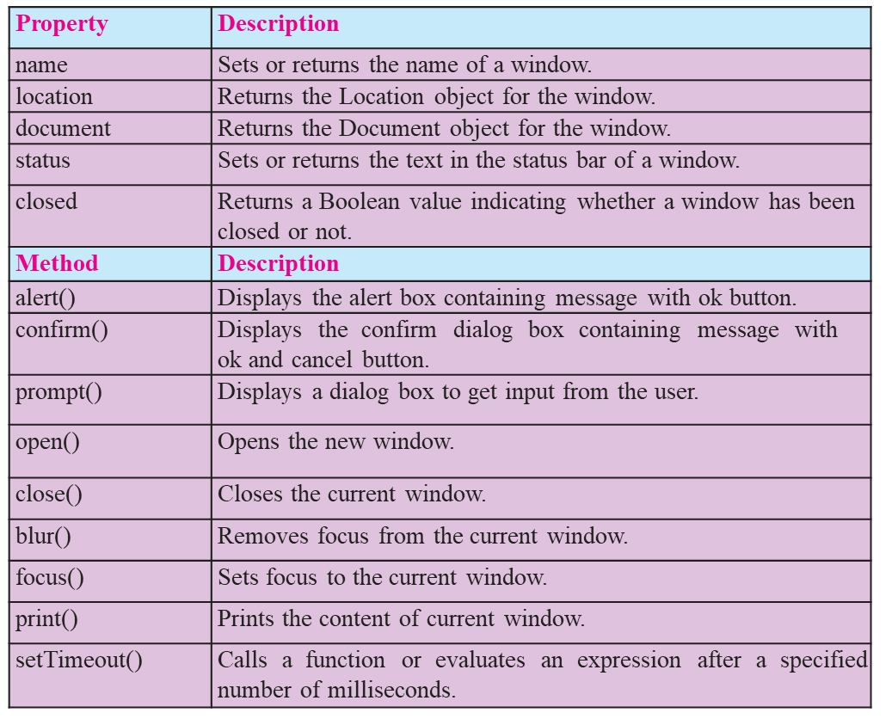
PIMPRI CHINCHWAD EDUCATION TRUST’S S.B.PATIL COLLEGE OF Science and Commerce, Ravet
Window Object :
At the very top of the object hierarchy is the window object. Window object is parent object of all other objects. It represents an open window in a browser.
An object of window is created automatically by the browser. Window object represents an open window in a browser.
Following table shows some of the methods and properties for window object.

Slide 20
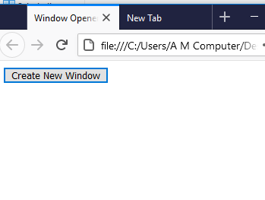
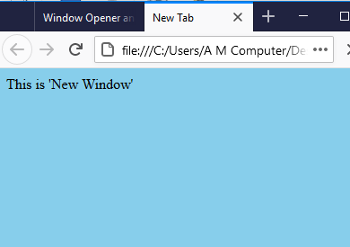
PIMPRI CHINCHWAD EDUCATION TRUST’S S.B.PATIL COLLEGE OF Science and Commerce, Ravet
Program :
<!DOCTYPE html>
<html>
<head> <title> Window Opener and Closer </title>
<script type="text/javascript">
function makeNewWindow()
{
var newwin=window.open();
newwin.document.write("<p>This is 'New Window'</p>");
newwin.document.body.style.backgroundColor = "skyblue";
}
</script></head>
<body>
<form>
<input type="button" value="Create New Window" onClick="makeNewWindow()">
</form> </body>
</html>
Before button click
Output
After button click

Slide 21
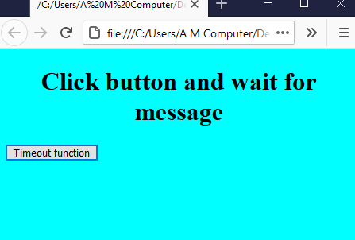
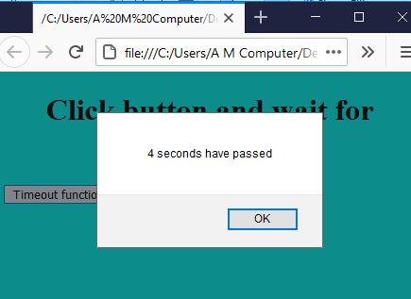
PIMPRI CHINCHWAD EDUCATION TRUST’S S.B.PATIL COLLEGE OF Science and Commerce, Ravet
Program :
<!DOCTYPE html>
<html>
<head>
<script type="text/javascript">
function sampleFunction()
{
window.setTimeout(next(), 4000);
}
function next()
{
alert("4 seconds have passed");
}
</script></head>
<body style="background -color:cyan">
<h1 align="center"> Click button and wait for message </h1>
<input type="button" value="Timeout function" onClick="sampleFunction()">
</body> </html>
Before button click
Output
After button click

Slide 22
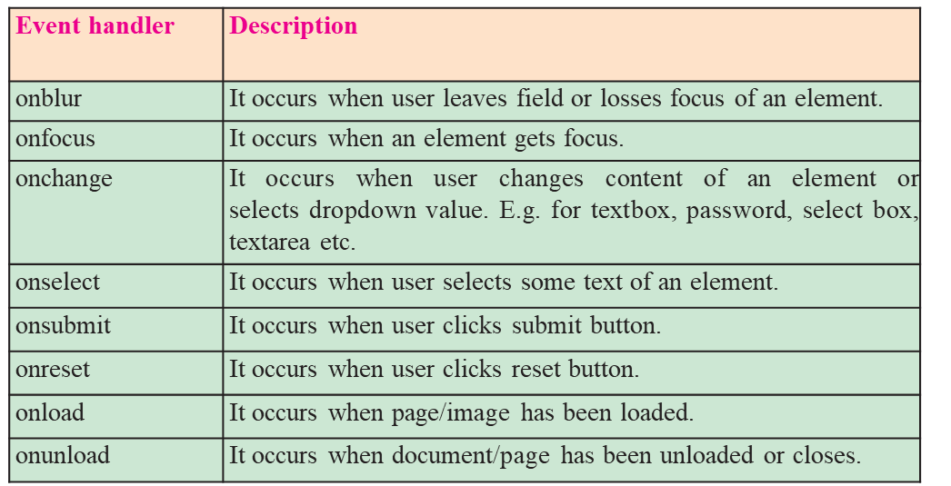
PIMPRI CHINCHWAD EDUCATION TRUST’S S.B.PATIL COLLEGE OF Science and Commerce, Ravet
3.4 JavaScript Event
Events are actions done by the user or an application that occurs on the webpage. In previous year we studied different keyboard events (onKeypress, onKeydown, onkeyup) and mouse events (onClick, onMousemove, onMouseout, onMouseover). Similarly there are some more events used with form objects.

Slide 23
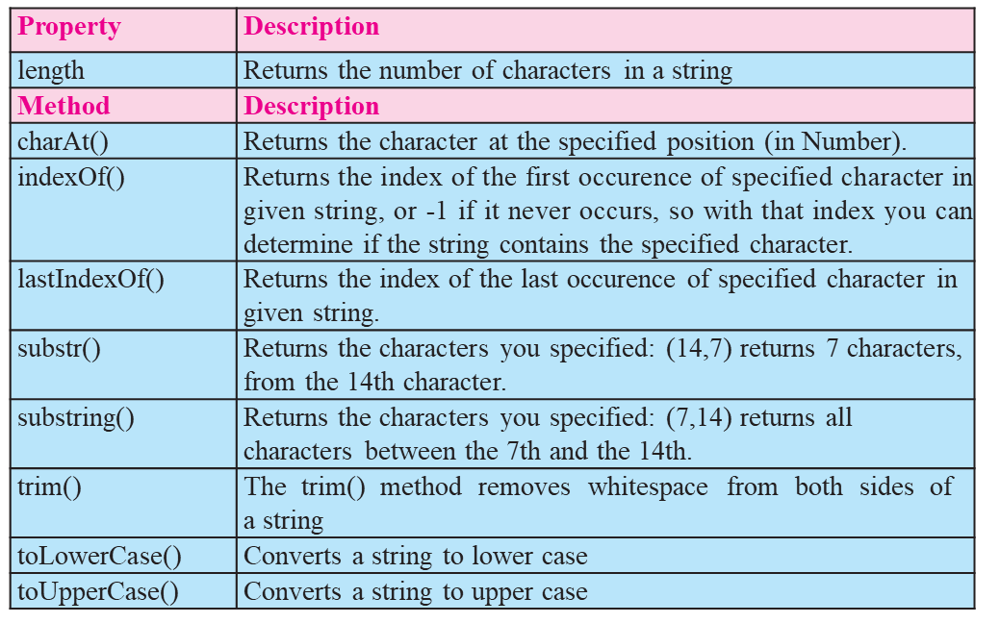
PIMPRI CHINCHWAD EDUCATION TRUST’S S.B.PATIL COLLEGE OF Science and Commerce, Ravet
3.5 JavaScript Built-in Objects
JavaScript has several built-in or core language objects. These built-in objects are available regardless of window content and operates independently of whatever page browser has loaded. These objects provide different properties and methods that are useful while creating live web pages.
String Object :
String is used to store zero or more characters of text within single or double quotes.
String object is used to store and manipulate text.

Slide 24
PIMPRI CHINCHWAD EDUCATION TRUST’S S.B.PATIL COLLEGE OF Science and Commerce, Ravet
Example :
var str="Information Technology";
document.write ("length of string is :-" + str.length);
document.write ("Substring is :-" + str.substr (12,10));
Document.write(“Character at 1st location is :”+str.charAt(1));
Output :
Length of string is :-22
Substring is :- Technology
Character at 1st location is : n
Example :Convert the value of txt to upper case.
var txt = "Hello World";
var txt1 = txt.toUpperCase();
var txt2=txt.toLowerCase();
Output: txt1 = HELLO WORLD
txt2= helloworld
Example :
Find the position of the character h in the string txt.
var txt = "abcdefghijklm";
var pos = txt. indexOf("h");
Output : pos= 8
Example :
var str = "Apple, Banana, Kiwi";
var res = str.substr(7);
Output: res= Banana, Kiwi
Example :
var str = "Hello planet earth, you are a great planet.";
var n = str.lastIndexOf("planet");
Output n= 36

Slide 25
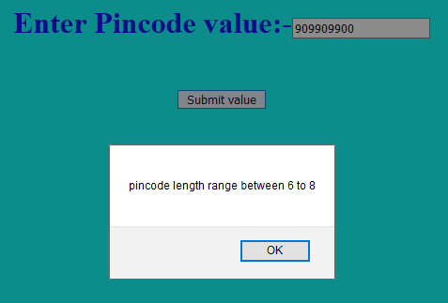
PIMPRI CHINCHWAD EDUCATION TRUST’S S.B.PATIL COLLEGE OF Science and Commerce, Ravet
<!DOCTYPE html>
<html><head><title>Pincode Validation</title></head>
<body style="color:blue;background-color:cyan">
<form name="form1">
<h1 align="center">
Enter Pincode value:-<input type="text" name="t1"><br><br>
<input type="button" value="Submit value" onClick="validate()">
</h1>
<script type="text/javascript"> function validate()
{
var pincode;
pincode=form1.t1.value;
if(pincode.length==0)
{
alert("please check, enter value"); form1.t1.focus();
}
else if(isNaN(pincode))
{
alert("please, enter integer number only"); form1.t1.focus();
}
else if(pincode.length<6||pincode.length>8)
{
alert("pincode length range between 6 to 8"); form1.t1.focus(); }
else
alert("Pincode is accepted");
}
</script> </body></html>

Slide 26
PIMPRI CHINCHWAD EDUCATION TRUST’S S.B.PATIL COLLEGE OF Science and Commerce, Ravet
Summary
JavaScript is light weight scripting language. It is platform independent language.
There are two types of scripts; client side script and server side scripts. Client side scripts reside on client machine and server side script resides on web server.
JavaScript provide ‘switch…case’ as multi way decision statement.
For....loop, while…loop and do…while are commonly used looping structures in JavaScript.
DOM (Document Object Model) is a programming interface for HTML and XML documents. It defines logical structure of document.
Window object is parent object of all other objects hence its methods can be used without specifying it.
JavaScript is event based language support objects events such as onBlur, onFocus, onChange, onSelect, onSubmit, onLoad, onUnload, onResize etc.
JavaScript supports built-In objects such as Date, String, Math, Number and array etc. These objects contain number of properties and methods that are useful while creating interacting web pages.

Slide 27
PIMPRI CHINCHWAD EDUCATION TRUST’S S.B.PATIL COLLEGE OF Science and Commerce, Ravet
Thank you !

